Slide 1

Machine Learning 101: English alphabet ocr
Identifying letters through machine learning

Slide 2
intro
Throughout the past decade, machine learning has become the new trend in computer science, and has already been applied to many other fields. As a computer geek, I would very much like to learn this piece of innovative technology that brings much convenience to this world.
OCRs are extremely powerful. However, many OCRs suffer from misrecognition of distorted images, to counter this problem, I chose to use machine-learning technology to create this simple OCR project.

Slide 3
Neural networks
The Neural Network is the most popular model used in the field of machine learning.
Basically, it is a web of interconnected neurons, each holding a bias, and a number of weights depending on how many other neurons it is connected to.
It receives inputs, and after a series of calculations, outputs results. In supervised training, the machine will compare the results with predetermined answers (known as labels) to modify its weights and biases through back propagation. This process is known as learning, or training.

Slide 4
Project specifics
For this project, I built a Fully Connected Neural Network, which will be trained through 40,000 17*17px images of black and white English letters.
The network will only recognize individual letters, not words.

Slide 5
Inner workings
For training, I used 5 layers. The Input Layer takes in all the training data, passes it through the Fully Connected Layer, which is where the weights and biases are held, and then relays the data to the activation layer, which in this case, is also the output layer. It gives 26 decimals, each number indicating how high the machine “thinks” the possibility that the letter is the one shown in the image is. The one with the highest value is then the final result. Then it runs through the loss and accuracy layer, giving a loss value and accuracy value for me to evaluate the training process.
. . .
. . .
. . .
. . .
. . .
Input Layer
Fully Connected Layer
Activation Layer / Output Layer
Loss Layer
Accuracy Layer

Slide 6
Preprocessing
Preprocessing is the first step to machine learning.
Preparing the data for the computer to study upon is crucial, as everything is based on the preprocessed data.
Since the data I have is just black and white images of letters, all I have to do is to read them in and resize them.
An enlarged piece of data:

Slide 7
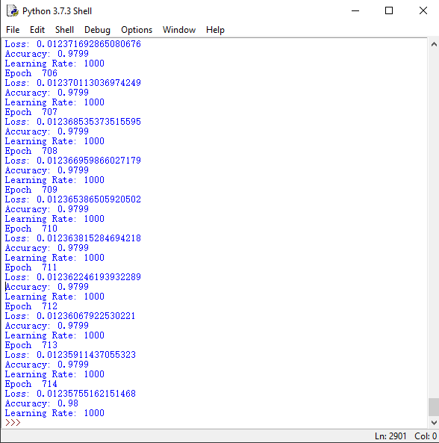

Training process
The training process is relatively easier.
Just observe the change of the loss value, and change the learning rate accordingly.
Here, I found 1000 to be the optimal learning rate, and after a total of 714 epochs, I raised the accuracy from none to 98%.
The trained results, which are the weights and biases, and then stored in two .csv files. These files can be loaded again if needed.

Slide 8
The main application
Just training it to have an accuracy of 98% isn’t enough. It’s time to put it into a real test.
By slightly changing the Training Program, I wrote OCR_Main.py, which reads in 1 image and predicts the letter in the image.
I drew a larger picture of a letter in MS Paint and saved it beside OCR_Main.py

Slide 9
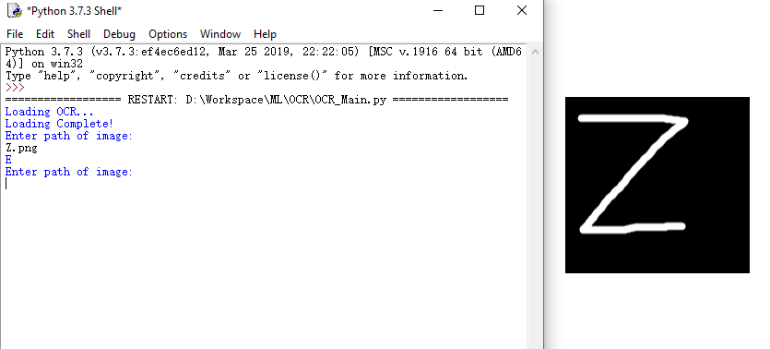
issues
The recognition (or prediction) didn’t go as well as I’d expected.
It turns out that the problem wasn’t because my weights and biases are overfitting or are improperly trained in any way. It was the preprocessing causing all the mess.
My preprocessing was WAY too simple, just reading it in and resizing it obviously cannot fulfill the requirements.
Therefore, I rewrote my preprocessing algorithm with OpenCV2

Slide 10
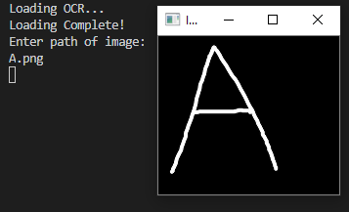


Final results
Through step resizing and dilation, I successfully retained the key pixel data inside an image.

Slide 11

Thank You!
1324555186@QQ.com

